Slide 1
Regression Analysis
Model Selection
Nicoleta Serban, Ph.D.
Professor
Stewart School of Industrial and Systems Engineering
Introduction

Slide 2

About This Lesson

Slide 3
Objectives
High Dimensionality: When we have a very large number of predicting variables to consider, it can be difficult to interpret and work with the fitted model.
Multicollinearity: When the predicting variables are correlated, it is important to select variables in such a way that the impact of multicollinearity is minimized.
Prediction vs Explanatory Objective: The variables selected for the two objectives will most often be different.
➔ Variable Selection addresses all these concerns.

Slide 4
Implications and Words of Caution
Controlling vs. Explanatory Variables
  Consider research hypothesis as well as potential controlling variables
Targeted Predicting Variables
  Include target variable in model if specified by research hypothesis
Over-Interpretation
  Selected variables are not necessarily special!
  Highly influenced by correlations between variables
  Interpretation of regression coefficients
  Causality vs. Association

Slide 5
No Magic Bullet
Variable selection for large number of predicting variables is an “unsolved” problem in statistics
In some sense, model selection is “data mining”
Data miners / machine learners often work with many predictors
There are no magic procedures to get you the “best model”
“All models are wrong, but some are useful.” ―George Box

Slide 6
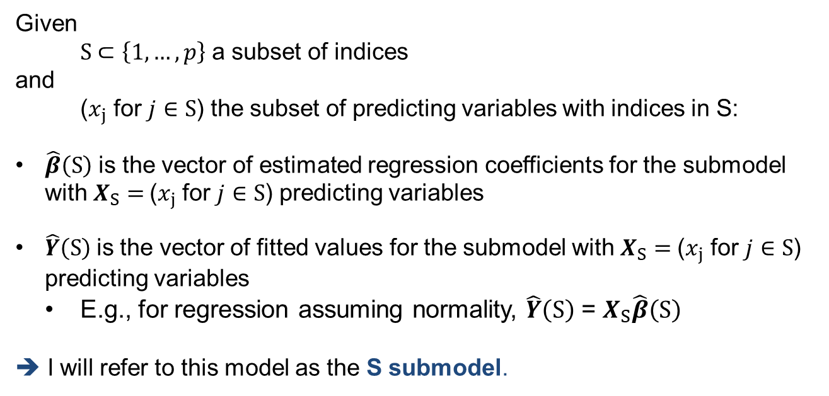
Notation
Given
S $⊂\left\{1,…,p\right\}$ a subset of indices
and
($x_{j}$ for $j∈S$) the subset of predicting variables with indices in S:
$\hat{β}\left(S\right)$ is the vector of estimated regression coefficients for the submodel with$X_{S}=$($x_{j}$ for $j∈S$) predicting variables
$\hat{Y}\left(S\right)$is the vector of fitted values for the submodel with $X_{S}=$($x_{j}$ for $j∈S$) predicting variables
  E.g., for regression assuming normality, $\hat{Y}\left(S\right)$ = $X_{S}\hat{β}\left(S\right)$
➔ I will refer to this model as the S submodel.

Slide 7

Summary

